Slide 1
COMP3000 PROJECT
VARIANCE

Slide 2

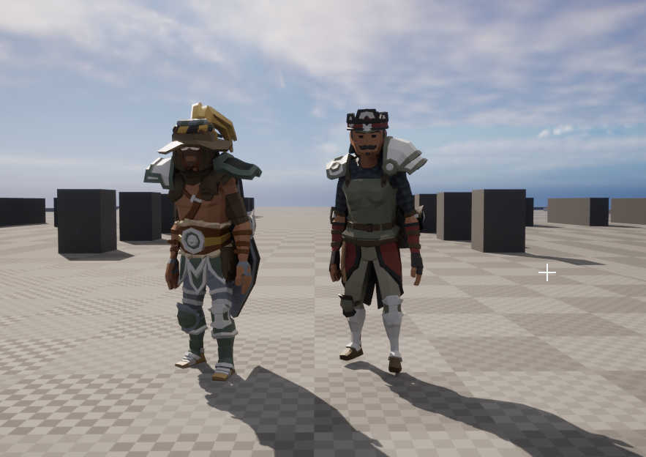
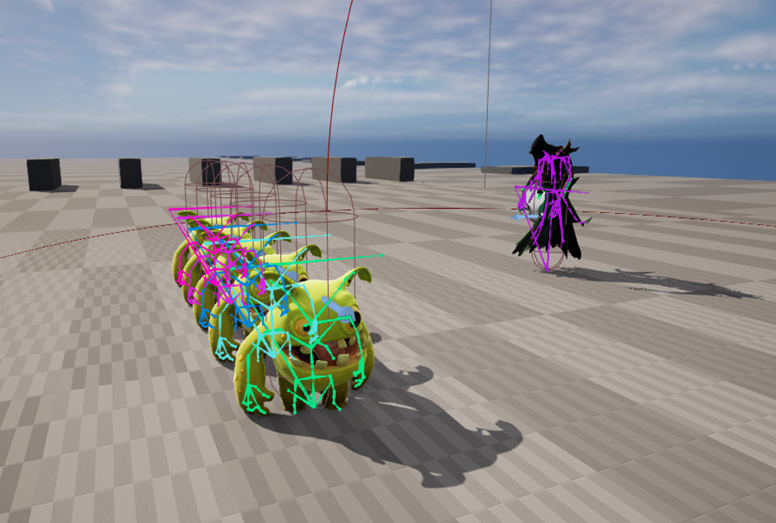
SPRINT 8 RESULTS
Enemy AI base system “completed” – Behavior tree, C++ tasks/Decorators.
Ranged enemy projectile prediction
Procedural character generation – Randomly constructs characters from 700 assets
Player shooting functionality + some VFX

Slide 3
Sprint 8 reflection
Missed a few previous sprints because of other modules
Cloth simulation of main character is completely broken
Optimize character generation with 1 skeletal mesh output (1 draw call vs 40)
Enemy ABP needs to be modularized into C++ for easier expansion
Need to catchup quickly to older sprint goals

Slide 4
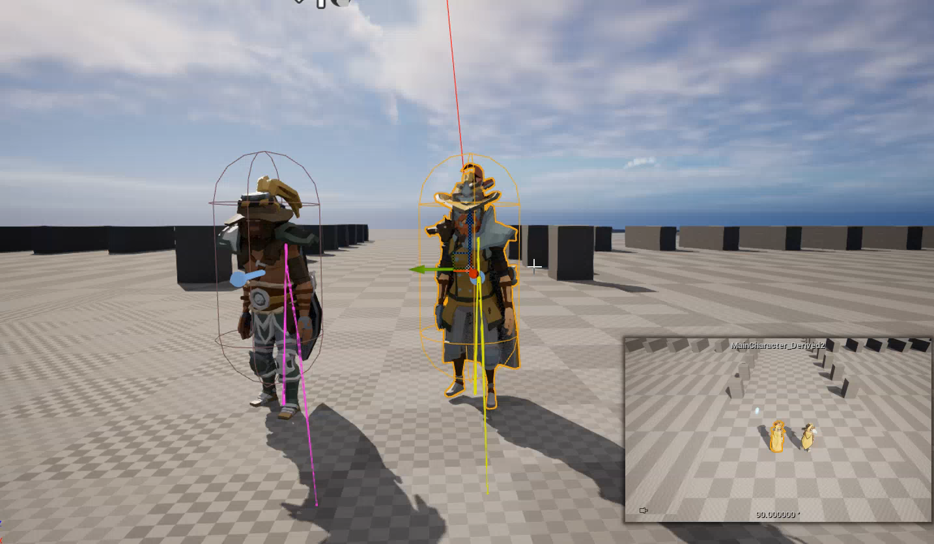

Slide 5
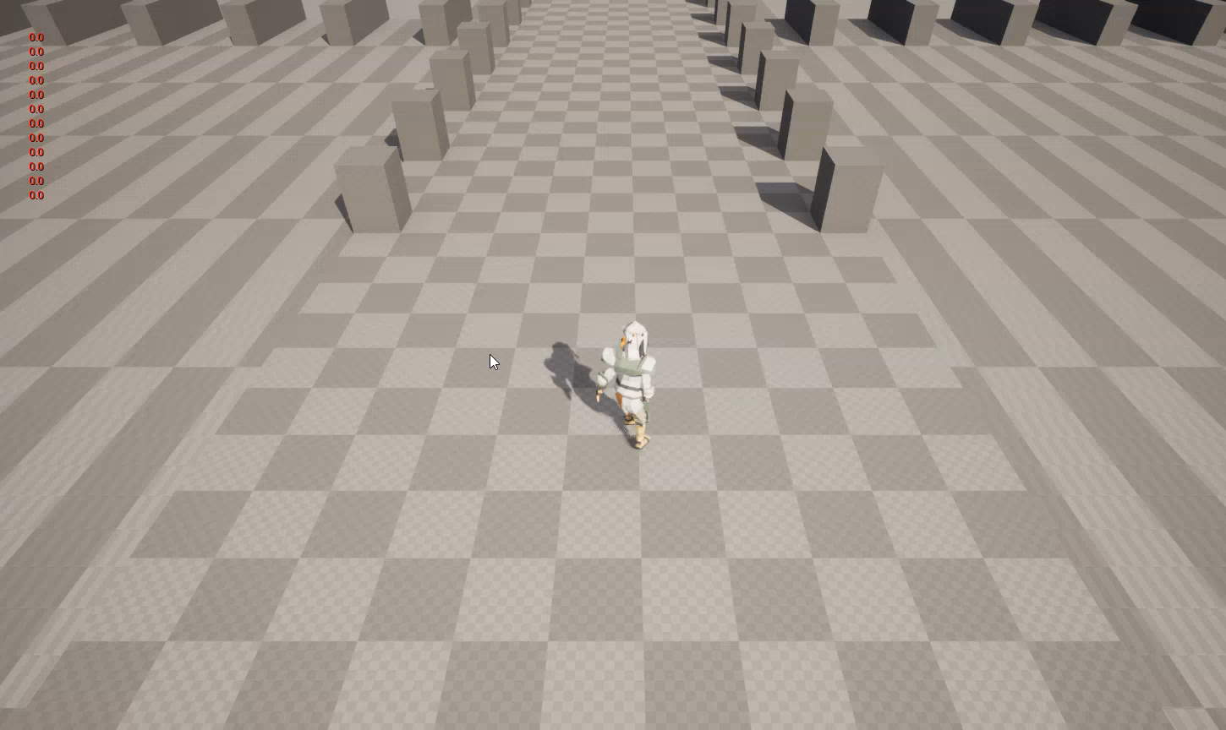

Slide 6
Sprint 9 goals
Start level implementation
Advanced AI
Optimizing character generation
Procedural leg animations - May use third party asset for this because control rig is mostly designed for Blueprints (no marks?)
Dodge-Roll, Health System, More attacking implementation

